Slide 1


“EchoNote”
Voice-Driven Smart Memos with AI
汇报组：第七小组
时间：2025.5

Slide 2



01
Background and Motivation
02
Related Work
目录
目录
03
Project Goals and challenge
Contents
Contents
04
Work Plan and Division of work

Slide 3


1
Background and Motivation

Slide 4
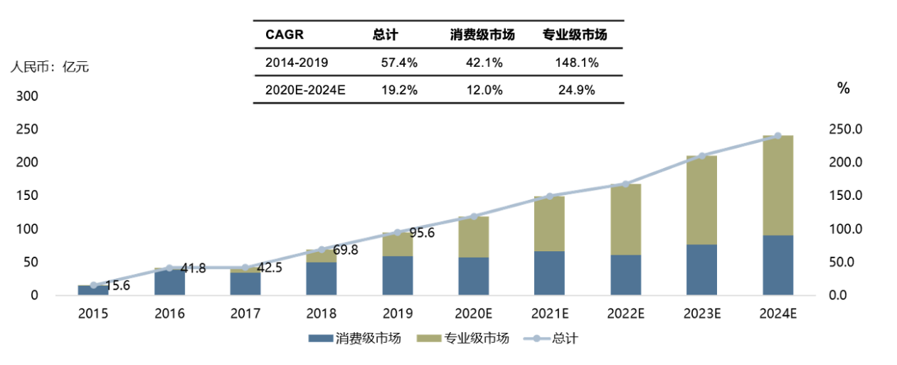

Background
In the mobile era, traditional text input is inefficient and cumbersome.
More users now prefer voice input to quickly capture ideas and tasks.
Data shows:
China's speech recognition market reached ¥22.5 billion in 2024, doubling since 2020.
Voice interaction has become a mainstream trend.

Slide 5
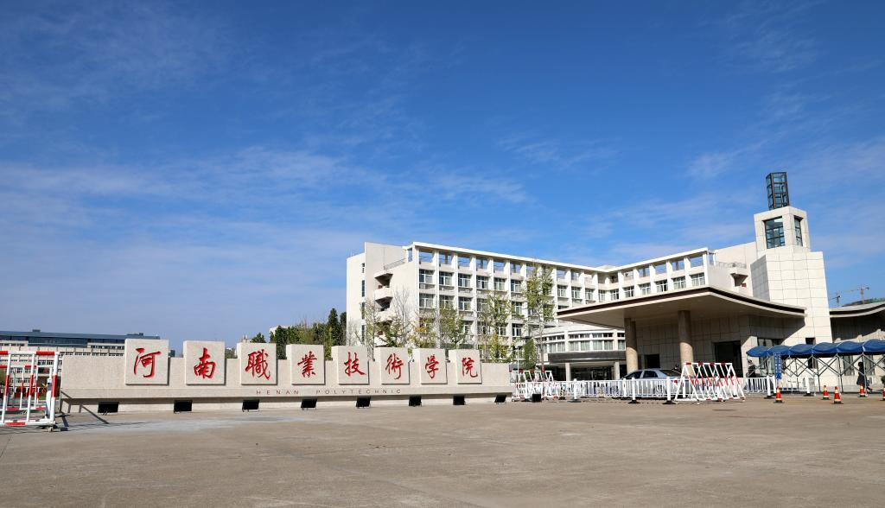


Motivation
Missing Intelligence in Memo Apps
Our Solution
No smart categorization (缺乏智能分类)
Limited AI integration (AI整合不足)
Basic voice recognition (语音识别简陋)
Speech-to-Text API (语音转文字)
NLP-powered tagging (自然语言处理打标)
Proactive assistant (主动式助手)
From Storage to Intelligence
Frictionless Interaction
Auto-categorize (自动分类)
Context-aware (情境感知)
Multi-scenario ready (多场景适配)
1-tap recording (一键记录)
Real-time processing (实时处理)
Dashboard overview (信息可视化)

Slide 6


2
Related Work

Slide 7

Related Product
1. Microsoft OneNote
2.Apple Notes
3.Memos

Slide 8

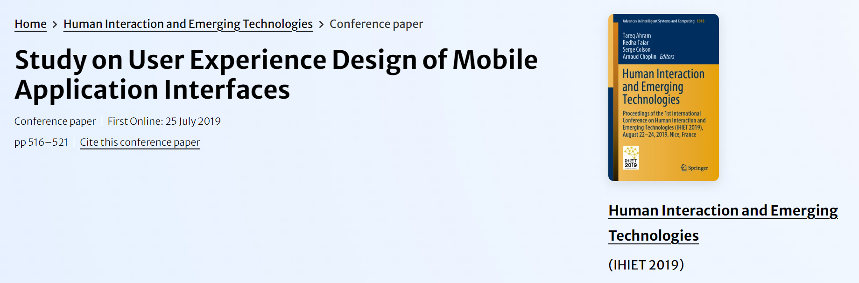
Related Research
This paper studies the interface design of smartphone APP so as to construct the interface design of user experience oriented smartphone APP from the three levels of feeling, cognition and sense

Slide 9
Identified Challenges and Improvement Opportunities
1.Lacks intelligent automation, requiring heavy manual user input
2.Lacks personalization and customization capabilities
3.Complex feature overload confuses new users

Slide 10

3
Project Goals and challenge

Slide 11


Project Goals
Implement a voice-driven high-efficiency recording system
Frictionless UX with cognitive affordances
Deliver intelligent information processing capabilities
Enable voice-command execution with cognitive search capabilities

Slide 12
Challenges
1.Speech recognition accuracy remains unstable
·Environmental noise interference (环境噪声干扰)
·Dialect/accent variations (方言/口音差异)
·Speech rate fluctuations (语速波动)
2.Steep learning curve for multi-tech adoption
·Voice recognition APIs (语音识别API)
·Mini-program frameworks (小程序框架)
·Interactive UI design (交互设计)
3.High integration complexity
·ASR ↔ NLP pipeline alignment(语音识别与自然语言处理对接)
·Frontend-backend data handoff(前后端数据交接)
4.Compressed testing phases
Limited user testing iterations(用户测试轮次不足)

Slide 13

4
Work Plan and Division of work

Slide 14
Work Plan
Week | Key Deliverables
Week 10 | Requirement finalization & role assignment
Week 11 | Tech stack training & framework setup
Week 12 | Core speech recognition implementation
Week 13 | NLP module integration & testing
Week 14 | UI/UX design refinement
Week 15 | System integration & stress testing
Week 16 | Final polishing & presentation prep
Week 17 | Final defense showcase
政策实施

Slide 15
Work Plan
Member | Primary Tasks
王奕昕 | • Interaction Design • Final Presentation Delivery • PPT Crafting
马敏慧智 | • Speech Recognition Implementation • API Integration
刘震 | • Mini-Program Development • AI Feature Integration
Justin | • Interaction Design • System Integration & Testing

Slide 16

THANKS

